Slide 2
Important Information
TERMS OF USE
By using this presentation, you understand and agree to the following:
You understand that T. Rowe Price does not undertake to give investment advice in a fiduciary capacity by making available this presentation and that T. Rowe Price Associates, Inc., and/or its affiliates (“T. Rowe Price”), may receive revenue from products and services made available by T. Rowe Price, including investment management, servicing, or other fees related to making available and/or servicing certain investments on its recordkeeping platform.
To the extent you modify this presentation, you will not attribute this presentation to T. Rowe Price through co-branding or otherwise.
To the extent you provide investment recommendations to clients or prospective clients, you will not attribute any such recommendation(s) to
T. Rowe Price.
You are responsible for satisfying all applicable regulatory standards relating to this communication’s use by your firm, including all applicable content, approval, recordkeeping, and filing requirements.
As long as you agree to these terms, T. Rowe Price grants you a limited, personal, nontransferable, non-sublicensable, revocable, nonexclusive license to use this presentation in its entirety and only in the manner expressly permitted by T. Rowe Price.
Please insert your data/content where indicated and delete these terms of use and various instructions throughout the PPT before using.
LRN 2844704

Slide 3
Important Information
TERMS OF USE
T. Rowe Price Retirement Plan Services, Inc. and [XXXXXX] are not affiliated.
This material is provided for general and educational purposes only, and not intended to provide legal, tax or investment advice. This material does not provide recommendations concerning investments, investment strategies or account types; and not intended to suggest any particular investment action is appropriate for you. Please consider your own circumstances before making an investment decision.
The material does not constitute a distribution, an offer, an invitation, a personal or general recommendation or solicitation to sell or buy any securities in any jurisdiction or to conduct any particular investment activity.
Information and opinions presented have been obtained or derived from sources believed to be reliable and current; however, we cannot guarantee the sources’ accuracy or completeness. The views contained herein are as of the date noted on the material and are subject to change without notice; these views may differ from those of other T. Rowe Price group companies and/or associates. Under no circumstances should the material, in whole or in part, be copied or redistributed without consent from T. Rowe Price.
Unless indicated otherwise the source of all market data is T. Rowe Price.
T. Rowe Price Retirement Plan Services, Inc.
© 2023 T. Rowe Price. All Rights Reserved. T. ROWE PRICE, INVEST WITH CONFIDENCE, and the Bighorn Sheep design are, collectively and/or apart, trademarks of T. Rowe Price Group, Inc.
LRN 2844704

Slide 4

WELCOME
Investing Basics
Plan Name
Notes:
Hello, and welcome to Investing Basics, a presentation by T. Rowe Price – your retirement plan services provider.
Today we’ll discuss fundamentals of investing, from a retirement perspective and how your workplace retirement plan can help you achieve your long-term goals.
We’ll cover asset allocation, diversification, rebalancing investments, and explore features like your investment options and dollar cost averaging, that allow you to build assets over time.

Slide 5
TO LIVE WEB MEETING ATTENDEES
For security reasons, please do not speak or email any personal information during this meeting. For example, you should not give your address, Social Security number, or account information during this Web meeting.
TO PLAN SPONSORS AND ATTENDEES
This presentation should only be used as a visual presentation for T. Rowe Price Retirement Plan Services, Inc., client meetings. This program should not be altered in any manner.
This material has been prepared by T. Rowe Price Retirement Plan Services, Inc., for general and educational purposes only. This material does not provide recommendations concerning investments, investment strategies, or account types. It is not individualized to the needs of any specific investor and is not intended to suggest that any particular investment action is appropriate for you, nor is it intended to serve as the primary basis for investment decision-making. T. Rowe Price Retirement Plan Services, Inc., its affiliates, and its associates do not provide legal or tax advice. Any tax-related discussion contained in this website, including any attachments/links, is not intended or written to be used, and cannot be used, for the purpose of
(i) avoiding any tax penalties or (ii) promoting, marketing, or recommending to any other party any transaction or matter addressed herein. Please consult your independent legal counsel and/or tax professional regarding any legal or tax issues raised in this material.
Notes:
[SILENCE—KEEP ON SCREEN FOR 3 SECONDS
Note: Recording can be paused if participant wants to view for longer]

Slide 6



Understanding Investing for Retirement
1
2
3
Asset Allocation
Diversification
Adjusting Over Time
Notes:
Investing wisely for retirement is not rocket science. You do not need to be an expert investor to make good investment decisions when retirement planning.
Investing for retirement is as easy as 1 – 2 – 3.
There are 3 steps to building and maintaining a retirement plan portfolio.
• Asset allocation,
• Diversification, and
• Adjustment over time

Slide 7
Defining Asset Allocation
Asset allocation can help manage the overall risk of your portfolio while still pursuing growth.
Moderate Risk/Reward Potential
Providing financing to a company or government entity, generally moderate risk, moderate price fluctuation
Higher Risk/Reward Potential
Ownership in a company, generally highest risk, greater share price fluctuation
Stocks
Bonds
Money Market/ Stable Value
Low Risk/Reward Potential
Lowest risk, share price designed to avoid fluctuation (seeks to preserve $1/share but not guaranteed)
All investments involve risk, including possible loss of principal.
Notes:
Asset allocation, is how an investor divides, or allocates, his or her money among different asset classes. The three main asset classes are stocks; bonds; and short-term investments, such as a money market or stable value funds.
Thoughtful asset allocation within a portfolio can help reduce its overall risk from market fluctuations while still pursuing returns. However, asset allocation cannot assure a profit or protect against loss in a declining market.

Slide 8




What Is Diversification
Diversification is the concept of spreading your money over different types of assets and asset classes.
The goal is to help you deal with the ups and downs of the financial markets.
1
Stocks
2
Bonds
3
Money Market/
Stable Value
Diversification cannot assure a profit or protect against loss in a declining market.
Notes:
The second step to creating a portfolio is diversification. Diversification is the way in which money is spread across different types of assets and within asset classes with various degrees of risk. Diversification can help reduce exposure to risk but cannot assure a profit or protect against loss in a declining market.

Slide 9

Diversification: Geographical Location
01
Domestic Investments
02
International Investments
03
Global Investments
Notes:
Portfolios can be diversified in a few different ways. The first way to diversify is geographically or based on where stocks and bonds are located. For example, portfolios can be spread out domestically by investing only in the U.S, Internationally by investing only outside the U.S. And/or globally by investing worldwide.
Generally, international investments expose investors to the most risk, whereas domestic investments are often considered less risky, from a standpoint of an investor based in the US. And since global investments are a mix of the two, their risk factor falls somewhere in between.

Slide 10



Diversification: Market Capitalization
S
M
L
Small-Cap
Mid-Cap
Large-Cap
Notes:
Another way to diversify is by the size of the company– spreading monies between small, medium, and/or large companies.
Generally, the smaller the company, the higher the risk and the higher the growth potential. Small companies may struggle to stay afloat during market downturns, but they also have the potential to grow much larger over time.
Conversely, generally, the bigger the company, the lower the risk and the lower the growth potential. Larger companies typically have the stability and capital needed to ride out downturns in the market cycle, but they also may be past the growing stage of their business cycle that could have led to higher returns.

Slide 11
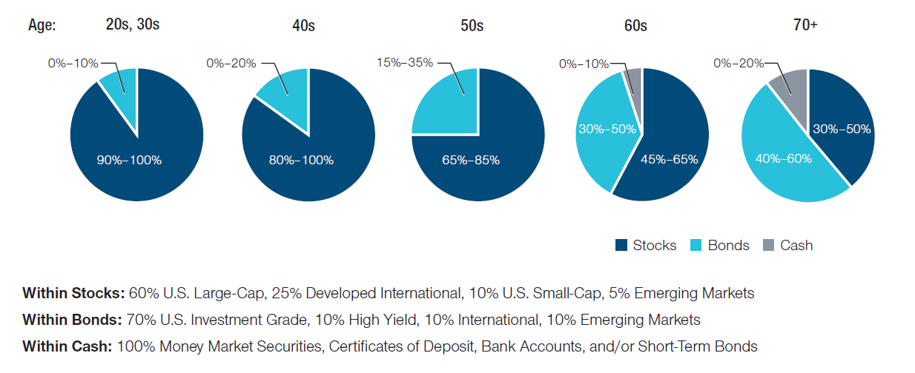
Diversification: Asset Allocation
The allocations are age-based only. Depending on your risk tolerance, time horizon, and financial situation, you may need to make adjustments. Diversification cannot assure a profit or protect against loss in a declining market.
Notes:
Now, let’s look at an example. Here’s how an investor might diversify the stock portion of a portfolio.
The graph you see here is not designed to be a model allocation, but rather an example to demonstrate how a stock portfolio can be diversified.
In general, younger investors can focus on growth and consider investing a significant portion of their savings into stocks.
As investors grow older, they generally reduce exposure to volatility and gradually increase investments in bonds and short-term investments, such as money market or stable value investments.
This slide provides guidance on asset allocation strategies for consideration based on an investor’s age.
Retirement savers should consider their financial situation, time horizon, and risk tolerance before making an investment decision. Diversification can help insulate a portfolio from sharp declines in any one segment, but it cannot assure a profit or protect against loss in a declining market.
Just remember—throughout your journey to retirement, it’s important to review your investment mix periodically. You’ll want to determine if you’re still on course with your investment goals.

Slide 12
ASSET ALLOCATION ASSUMPTIONS
Our asset allocation models are designed to meet the needs of a hypothetical investor with an assumed age of 65 at retirement and a withdrawal horizon of 30 years. The model allocations are based upon an analysis that seeks to balance long‐term return potential with anticipated short‐term volatility. The model reflects our view of appropriate levels of trade-off between potential return and short‐term volatility for investors of certain age ranges. The longer the time frame for investing, the higher the allocation is to stocks (and the higher the volatility) versus bonds or cash.
Limitations:
While the models have been designed with reasonable assumptions and methods, the tool provides hypothetical models only and has certain limitations.
The models do not take into account individual circumstances or preferences, and the model displayed for your age may not align with your accumulation time frame, withdrawal horizon, or view of the appropriate levels of trade-off between potential return and short-term volatility.
Investing consistent with a model allocation does not protect against losses or guarantee future results.
Please be sure to take other assets, income, and investments into consideration when reviewing results that do not incorporate that information. Other T. Rowe Price educational tools or advice services use different assumptions and methods and may yield different outcomes.

Slide 13

Diversification: Active vs. Passive Investing
Active
Portfolio built with deliberate decisions on what to buy/sell/hold
Managers select from defined universe
Generally seek to outperform a market index or strategy
Typically higher management fees
Passive
Portfolio built to match holdings and returns of a particular market index
Managers do not look into individual companies or securities
Seek to match performance of the particular market index, not to outperform
Typically lower management fees
Notes:
When making investment decisions for retirement savings, one thing to consider is active versus passively managed investments.
Actively managed investments are managed by an investment manager who makes daily deliberate decisions about what to buy, sell, and hold in order to meet specific investment objectives—generally, seeking to outperform a market index or strategy. Typically, because these investments are actively managed, they have higher management fees.
Passively managed investments, on the other hand, are built to mirror holdings and returns of a market index. They focus on matching the performance of a market index, not to outperform. Because these investments are passively managed, they typically feature lower management fees.
Both management styles can help investors achieve their retirement savings goals, but the decision comes down to which style an investor may prefer.

Slide 14
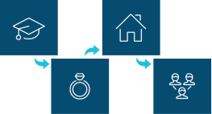

Adjusting Over Time
Do Not React to Market Volatility
When You Have a Major Life Event
As Your Time Horizon Changes
Notes:
We believe that adjustments should not be made in reaction to market fluctuations, believing that it’s important to stay level-headed and stick to a strategy. Emotional decisions based on short-term fluctuations may affect the long-term growth of an account.
An investor may wish to revisit his or her account after a major life event. Getting married; having children; or receiving windfalls, such as bonuses or an inheritance, may affect financial goals. At these times an investor may need to adjust his or her savings strategy, shifting it to match their new circumstances.
Finally, an investor may need to adjust their portfolio over time is if their time horizons change, for example, getting closer to retirement. Generally, the closer an investor gets to needing retirement money, the more conservative he or she may want to be with investments.

Slide 15



What Causes Market Volatility?
Market volatility can be caused by several factors, including:
Geopolitical Events
Monetary Policy
Global Growth Rate and Valuations
Innovation
Notes:
Let’s talk a little bit about market volatility, meaning rapid, dramatic changes in the day-to-day markets.
Many things can trigger financial market shifts - As these different events create a ripple effect onto others, affecting the daily value of your investments. Remember Market volatility is normal and understanding why it happens can help you manage your risk.
What causes market volatility? There are many factors, but here we’ve listed a few:
Innovation: When a new product or service enters a market, it can cause disruption, which can impact existing businesses.
Global Growth Rate: This is the pace in which different countries grow. Shifts in growth rate within countries can cause a shift in their economies.
Geopolitical Events: Environmental change can impact national policy implementations, which can also impact economies.
Valuations: Valuations of businesses can change over time due to earnings reports, revenue, projected growth, and much more.
Monetary Policy: these are the policies put in place by central banks that impact businesses directly.
These are just some of many factors that can affect the market on a daily basis.

Slide 16
Looking at the Market Through a 15-Year Lens
As of December 31, 2022
S&P 500 Index: Returns Tend to Stabilize Over the Longer Term
%
Past performance is not a reliable indicator of future performance.
Sources: T. Rowe Price, created with Morningstar Direct; S&P. See Additional Disclosures. Price return calculations include dividends and capital gains. Annual returns beginning in calendar year 1970. Rolling 15-year data beginning in 1970. It is not possible to invest directly in an index. Chart is for illustrative purposes only.
Notes:
OPTIONAL SLIDE
Let’s take the last 50 years and look at one-year returns and rolling 15-year returns.
In 1970, the one-year return was 4%. But the average annual 15-year return ending in 1970 was 8%. In 1971, the one-year return was 14%; the 15-year return was 9%. One-year returns bounce around—a lot!

Slide 17
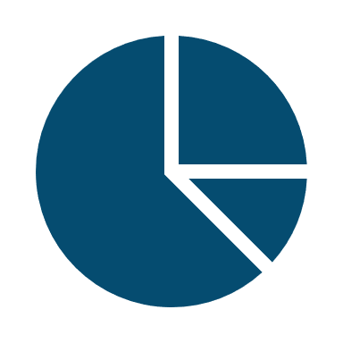


Rebalancing
Bringing asset allocation targets back in line
Original asset allocation
Stocks 60%
Stock market goes down
Bonds 30%
Rebalance back to original asset allocation plan
Cash 10%
This illustration is hypothetical and does not represent the returns of any security. Investments are subject to market risk.
Notes:
When building a portfolio another item to consider is rebalancing. Once assets are allocated and diversified, it’s important to adjust a portfolio over time. One reason investors should rebalance their portfolio is because markets can cause asset allocations to shift, and the new allocation may not align with their original investment strategy. We suggest that investors review their asset allocation at least once a year to see if their portfolio needs rebalancing, or adjustments, to restore their desired investment strategy. Because, once established, the original asset allocation plan may drift off course as the markets change.

Slide 18
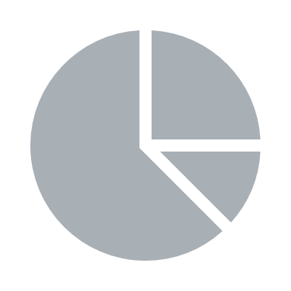

Rebalancing
Bringing asset allocation targets back in line
Original asset allocation
Stocks 45%
Bonds 40%
Stock market goes down
Cash 15%
WHEN STOCKS DECLINE
Rebalance back to original asset allocation plan
CASH AND BONDS MAY INCREASE
This illustration is hypothetical and does not represent the returns of any security. Investments are subject to market risk.
Notes:
When the stock market goes down and stocks decline in value, an investor’s portfolio may shift and as a result, hold less in stocks and more in bonds and short-term investments or cash equivalents – making it more conservative than they may have originally wanted.

Slide 19

Rebalancing
Bringing asset allocation targets back in line
Original asset allocation
Stocks 60%
Stock market goes down
Bonds 30%
Rebalance back to original asset allocation plan
Cash 10%
This illustration is hypothetical and does not represent the returns of any security. Investments are subject to market risk.
Notes:
By moving some of their excess holdings in cash and bonds to stocks, they’re not only rebalancing their portfolio back to their original asset allocation, the investor is also following one of the golden rules of investing; buy low and sell high. By simply checking in periodically and balancing your account, your portfolio can stay on course with your goals and objectives.

Slide 20

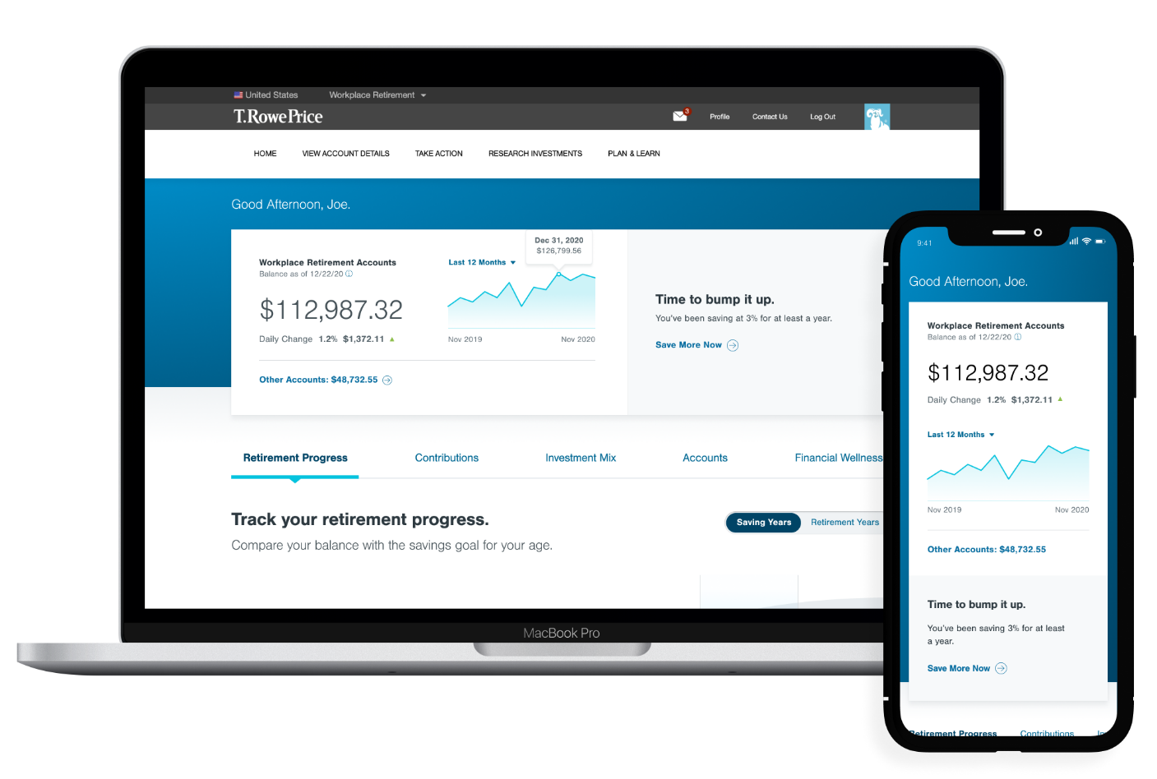
Online Tools to Help You Plan
Note: Tips and tools to help you
plan for retirement, save for college,
pay down debt, and more.
Check in on your progress
toward retirement
Log in wherever
you are, whatever
your device
Quickly view
and access
accounts and
balances
rps.troweprice.com
Notes:
Your workplace retirement website has the tools to help you plan for retirement—and beyond.
Think of your plan website as a one-stop source for information, insights, and tools around financial wellness and retirement.
Every time you log in, the first thing you’ll see is a personalized road map showing your progress on the road to retirement. Just use the slider to see how much we think you’ll need to have saved at each decade of your life. You can also experiment with changing your savings rate—in the “Contributions” section—and preview the impact on your paycheck and your total contribution.
Your workplace retirement website has the tools to help you plan for retirement—and beyond.

Slide 21

Actions to Consider
1
Keep a Long-Term Perspective
2
Allocate and Diversify Appropriately
3
Reallocate and Rebalance as Needed
4
Contribute Consistently to Your Retirement Plan
5
Call T. Rowe Price to Review Your Investments if You Have Questions
Notes:
To summarize our discussion, remember the following:
Keep a long term perspective
Review your asset allocation to match your goals and time horizon
Maintain your portfolio by reviewing your investments periodically and rebalance when necessary
Continue to contribute
We are here to help with any questions

Slide 22
Additional Disclosures
©2023 Morningstar, Inc. All rights reserved. The information contained herein: (1) is proprietary to Morningstar and/or its content providers; (2) may not be copied or distributed; and (3) is not warranted to be accurate, complete, or timely. Neither Morningstar nor its content providers are responsible for any damages or losses arising from any use of this information. Past performance is no guarantee of future results.
Copyright © 2023, S&P Global Market Intelligence (and its affiliates, as applicable). Reproduction of any information, data, or material, including ratings (“Content”) in any form is prohibited except with the prior written permission of the relevant party. Such party, its affiliates and suppliers (“Content Providers”) do not guarantee the accuracy, adequacy, completeness, timeliness, or availability of any Content and are not responsible for any errors or omissions (negligent or otherwise), regardless of the cause, or for the results obtained from the use of such Content. In no event shall Content Providers be liable for any damages, costs, expenses, legal fees, or losses (including lost income or lost profit and opportunity costs) in connection with any use of the Content. A reference to a particular investment or security, a rating or any observation concerning an investment that is part of the Content is not a recommendation to buy, sell, or hold such investment or security, does not address the suitability of an investment or security and should not be relied on as investment advice. Credit ratings are statements of opinions and are not statements of fact.

Slide 23

CLOSING
REMARKS.
Notes:
It’s your future. And it’s shaped by what you do today.
Save early and often for retirement in order to stay on track

Slide 24





1-800-922-9945
rps.troweprice.com
© 2023 T. Rowe Price. All Rights Reserved. T. ROWE PRICE, INVEST WITH CONFIDENCE, and the Bighorn Sheep design are, collectively and/ or apart, trademarks of T. Rowe Price Group, Inc. RETIRE WITH CONFIDENCE is a trademark of T. Rowe Price Group, Inc.
T. Rowe Price Retirement Plan Services, Inc.
202212-2615127
Notes:
If you have any questions about your plan, feel free to give us a call, we’re here to help.

