Slide 2

Important Information
TERMS OF USE
By using this presentation, you understand and agree to the following:
You understand that T. Rowe Price does not undertake to give investment advice in a fiduciary capacity by making available this presentation and that T. Rowe Price Associates, Inc., and/or its affiliates (“T. Rowe Price”), may receive revenue from products and services made available by T. Rowe Price, including investment management, servicing, or other fees related to making available and/or servicing certain investments on its recordkeeping platform.
To the extent you modify this presentation, you will not attribute this presentation to T. Rowe Price through co-branding or otherwise.
To the extent you provide investment recommendations to clients or prospective clients, you will not attribute any such recommendation(s) to T. Rowe Price.
You are responsible for satisfying all applicable regulatory standards relating to this communication’s use by your firm, including all applicable content, approval, recordkeeping, and filing requirements.
As long as you agree to these terms, T. Rowe Price grants you a limited, personal, nontransferable, non-sublicensable, revocable, nonexclusive license to use this presentation in its entirety and only in the manner expressly permitted by T. Rowe Price.
Please insert your data/content where indicated and delete these terms of use and various instructions throughout the PPT before using.
LRN 2844704

Slide 3
Important Information
TERMS OF USE
T. Rowe Price Retirement Plan Services, Inc. and [XXXXXX] are not affiliated.
This material is provided for general and educational purposes only, and not intended to provide legal, tax or investment advice. This material does not provide recommendations concerning investments, investment strategies or account types; and not intended to suggest any particular investment action is appropriate for you. Please consider your own circumstances before making an investment decision.
The material does not constitute a distribution, an offer, an invitation, a personal or general recommendation or solicitation to sell or buy any securities in any jurisdiction or to conduct any particular investment activity.
Information and opinions presented have been obtained or derived from sources believed to be reliable and current; however, we cannot guarantee the sources’ accuracy or completeness. The views contained herein are as of the date noted on the material and are subject to change without notice; these views may differ from those of other T. Rowe Price group companies and/or associates. Under no circumstances should the material, in whole or in part, be copied or redistributed without consent from T. Rowe Price.
Unless indicated otherwise the source of all market data is T. Rowe Price.
T. Rowe Price Retirement Plan Services, Inc.
© 2023 T. Rowe Price. All Rights Reserved. T. ROWE PRICE, INVEST WITH CONFIDENCE, and the Bighorn Sheep design are, collectively and/or apart, trademarks of T. Rowe Price Group, Inc.
LRN 2844704

Slide 4

Retirement Savings Strategies
[[AD_HOC:ClientName]

Slide 5
This material has been prepared by T. Rowe Price Retirement Plan Services, Inc., for general and educational purposes only. This material does not provide recommendations concerning investments, investment strategies, or account types. It is not individualized to the needs of any specific investor and not intended to suggest any particular investment action is appropriate for you nor is it intended to serve as the primary basis for investment decision-making. T. Rowe Price Retirement Plan Services, Inc., its affiliates, and its associates do not provide legal or tax advice. Any tax-related discussion contained in this website, including any attachments/links, is not intended or written to be used, and cannot be used, for the purpose of (i) avoiding any tax penalties or (ii) promoting, marketing, or recommending to any other party any transaction or matter addressed herein. Please consult your independent legal counsel and/or professional tax advisor regarding any legal or tax issues in this material.

Slide 6
Why are we here?
Your savings today becomes your income in retirement.
ACCUMULATION
DISTRIBUTION
Today
Retirement
Notes:
[static slide – will not change]
Rep Talking Points:
Review why it’s important to save for retirement
Consider what income will be when no longer working
Que up that the employer sponsored retirement plan is a benefit to help save and invest for a comfortable retirement

Slide 7
Compounding
40K SALARY EXAMPLE
Saving 15% per month
Before-Tax Account Value at Age 65
Years of Saving
10 years
no contributions
$918,000
no contributions
35 years
$861,000
45 years
$1,779,000
Age 20
30
65
This chart is for illustrative purposes only and is not meant to represent the performance of any specific investment option. Final account balances are rounded to the nearest thousand. Assumes $40,000 salary with $500 invested each month in a tax-deferred account and a 7% annual rate of return for a hypothetical investor from age 20 to age 65. The Account Values at age 65 are tax-deferred and contributions and earnings are subject to taxes upon withdrawal.
All investments involve risk, including possible loss of principal.
Source: T. Rowe Price
Notes:
[Static slide - $40,000 Salary Example (15% = 500/month)]
Rep Talking Points:
Review concept of compounding
Discuss impact of starting early vs. waiting
Engage audience, asking for guesses on which scenario (between first 2) pays off more. End with longer example
Save early and often
Discuss impact of contributing continuously vs. stopping after 10 years
Note: This example uses $500 as the monthly contribution because that is 15% of a $40,000 annual salary.

Slide 8
Compounding
60K SALARY EXAMPLE
Saving 15% per month
Before-Tax Account Value at Age 65
Years of Saving
10 years
no contributions
$1,377,000
no contributions
35 years
$1,291,000
45 years
$2,668,000
Age 20
30
65
This chart is for illustrative purposes only and is not meant to represent the performance of any specific investment option. Final account balances are rounded to the nearest thousand. Assumes $60,000 salary with $750 invested each month in a tax-deferred account and a 7% annual rate of return for a hypothetical investor from age 20 to age 65. The Account Values at age 65 are tax-deferred and contributions and earnings are subject to taxes upon withdrawal.
All investments involve risk, including possible loss of principal.
Source: T. Rowe Price
Notes:
[Static slide - $60,000 Salary Example (15% = $750/month)]
Rep Talking Points:
Review concept of compounding
Discuss impact of starting early vs. waiting
Discuss impact of contributing continuously vs. stopping after 10 years

Slide 9
Compounding
80K SALARY EXAMPLE
Saving 15% per month
Before-Tax Account Value at Age 65
Years of Saving
10 years
no contributions
$1,837,000
no contributions
35 years
$1,721,000
45 years
$3,558,000
Age 20
30
65
This chart is for illustrative purposes only and is not meant to represent the performance of any specific investment option. Final account balances are rounded to the nearest thousand. Assumes $80,000 salary with $1,000 invested each month in a tax-deferred account and a 7% annual rate of return for a hypothetical investor from age 20 to age 65. The Account Values at age 65 are tax-deferred and contributions and earnings are subject to taxes upon withdrawal.
All investments involve risk, including possible loss of principal.
Source: T. Rowe Price
Notes:
[Static slide - $80,000 Salary Example (15% = $1000/month)]
Rep Talking Points:
Review concept of compounding
Discuss impact of starting early vs. waiting
Discuss impact of contributing continuously vs. stopping after 10 years

Slide 10
Compounding
80K SALARY EXAMPLE
Saving 15% per month
Before-Tax Account Value at Age 65
Years of Saving
10 years
no contributions
$2,296,000
no contributions
35 years
$2,151,000
45 years
$4,447,000
Age 20
30
65
This chart is for illustrative purposes only and is not meant to represent the performance of any specific investment option. Final account balances are rounded to the nearest thousand. Assumes $100,000 salary with $1,250 invested each month in a tax-deferred account and a 7% annual rate of return for a hypothetical investor from age 20 to age 65. The Account Values at age 65 are tax-deferred and contributions and earnings are subject to taxes upon withdrawal.
All investments involve risk, including possible loss of principal.
Source: T. Rowe Price
Notes:
[Static slide - $100,000 Salary Example (15% = $1250/month)]
Rep Talking Points:
Review concept of compounding
Discuss impact of starting early vs. waiting
Discuss impact of contributing continuously vs. stopping after 10 years

Slide 11
Plan features
Plan Eligibility
You are eligible to participate in the plan [[AD_HOC:PlanSpecificDetail]]
Contribution Limits
Contribution Types
Company Contributions
Vesting Schedule
Notes:
[Plan specific slide – Participant money in]
Rep Talking Points:
Reviews plan specific eligibility requirements

Slide 12
Auto-enroll
Automatically enrolls eligible employees into employer’s retirement plan
You must give specific instructions to be excluded (opt out) during a specific grace period
You are enrolled with a default deferral percentage and investment option
Can change your contribution amount and investment at any time
Notes:
[Static slide]
Rep Talking Points:
Review auto-enroll details including
When
Opt out
Default investment and deferral

Slide 13
Plan features
Plan Eligibility
You can contribute:
Between [%] and [%] of your pay to your plan
Up to the IRS limit:
$22,500 for 2023
Up to an additional $7,500 if you will be age 50 or over by the end of the year and contribute the maximum allowed by your plan
Contribution Limits
Contribution Types
Company Contributions
Vesting Schedule
Notes:
[Plan specific slide – Participant money in]
Rep Talking Points:
Reviews plan specific participant contribution limits
Reviews IRS contribution limits for applicable year
MUST be clear that participant can contribute up to the LESSER of the plan percentage limit or the IRS contribution limit
Gears in bottom right hand corner link to auto-enroll slides, if applicable

Slide 14
Plan features
Plan Eligibility
You can make after-tax contributions to the plan
Contribution Limits
Contribution Types
Company Contributions
Vesting Schedule
Notes:
[Plan specific slide – Participant money in]
Rep Talking Points:
Reviews contribution types and how employer contributions are considered
Explains that a participant can designate THEIR contributions
Explains that company contributions are before-tax/roth/after-tax

Slide 15
Plan features
Plan Eligibility
Company Contribution:
[Plan Detail]
Contribution Limits
Contribution Types
Company Contributions
Vesting Schedule
Notes:
[Plan specific slide – company money in]
Rep Talking Points:
Reviews company contributions
Match program
Other contributions

Slide 16
Plan features
Plan Eligibility
Company Contribution:
You are always 100% vested in the salary deferral portion of your account.
Contribution Limits
Contribution Types
Vested percentage | Years of service
[[AD_HOC:Vest%]]% | [[AD_HOC:VestYears]]
Company Contributions
Vesting Schedule
You are always 100% vested in the salary deferral portion of your account.
Notes:
[Plan specific slide – Participant money in]
Rep Talking Points:
Reviews vesting schedule
Reiterates that salary deferrals are always 100% vested

Slide 17
Plan features
Plan Eligibility
You are eligible to participate in the plan if you are [[AD_HOC:PlanSpecificDetail]]
Contribution Limits
You can contribute between [%] and [%] of your pay to your plan up to the IRS limit: $22,500 for 2023. Additional $7,500 if you are over the age of 50
Contribution Types
You can make after-tax contributions to the plan
Notes:
[Plan specific slide – Participant money in]
Rep Talking Points:
Reviews plan specific eligibility requirements

Slide 18
Retirement savings: HOW MUCH SHOULD I HAVE?
Investor's Age: | Savings Benchmarks:
30 | half of salary saved today
35 | 1x to 1.5x salary saved today
40 | 1.5x to 2.5x salary saved today
45 | 2x to 4x salary saved today
50 | 3x to 6x salary saved today
55 | 4.5x to 8x salary saved today
60 | 5.5x to 11x salary saved today
65 | 7x to 13.5x salary saved today
15%*
Investors should strive to
SAVE
6%
AT LEAST
Consider increasing contributions by 2% gradually to build toward 15% target
*including company match
Key Assumptions: Household income grows at 5% until age 45 and 3% (the assumed inflation rate) thereafter. Investment returns before retirement are 7% before taxes, and savings grow tax-deferred. The person retires at age 65 and begins withdrawing 4% of assets (a rate intended to support steady inflation-adjusted spending over a 30-year retirement). Savings benchmark ranges are based on individuals or couples with current household income between $75,000 and $300,000. Target multiples at retirement reflect estimated spending needs in retirement (including a 5% reduction from preretirement levels), taxes, and Social Security benefits based on the SSA.gov Quick Calculator. Refer to the T. Rowe Price Insights piece, “You’re Age 35; 50; or 60: How Much Should You Have Saved for Retirement by Now?” for additional information.
Notes:
[Plan specific slide – plan DOES NOT offer a match]
Rep Talking Points:
Define the goal:
What are you saving for – to finance retirement, to have money to spend when no longer working
When – differs for everyone, at TRP we generally assume a person will retire around age 65
How much will it cost when you retire – everyone’s scenario is different, but again, we have some guidelines.
Achieving the goal:
How much to save… Reviews TRP savings guidance
Target 15% (They will voice over that that figure includes company match/contributions)
At a min save enough to get company match
If saving below 15%, increase contributions annually by 2% towards that target (rep will voice over to use auto-increase service, if offered, and can link to a slide with AI info via the gears in the bottom right)
Rep explains that these goals are to help you achieve the savings targets on the right, THIS IS THE HOW MUCH GUIDANCE and discusses that it’s easier to hit the higher goals later in life if they start early and save often
Rep should also explain quickly the account type. We know they have an employer plan… but a rep could also mention individual accounts here.
Moving on to investment strategy…

Slide 19
Annual contribution increases
2% contribution increase, with a 15% cap
6% contribution, with 7% annual return
$474,383
$208,395
Years
This is a hypothetical example for illustrative purposes only and is not meant to represent the investment return of any of your plan’s options. Assumes a starting salary of $25,000, which increases an average of 3% annually. The assumed initial contribution rate is 6%, with a 7% annual return. The example goes further to assume a 2% annual increase, with a 15% cap. Your situation will vary. Investing involves risk including possible loss of principal All investments involve risk, including possible loss of principal the performance of any specific investment option. The assumptions used may not reflect actual market conditions or your specific circumstances, and do not account for plan or IRS limits. Please be sure to take all of your assets, income, and investments into consideration in assessing your retirement savings adequacy.
Notes:
[Static slide]
Rep Talking Points:
Review concept of compounding
Discuss impact of increasing contributions annually and how that could improve the end result over time
Salary $25,000 6% contribution rate 7% annual return 3% annual salary increase
2% annual contribution increase with a 15% cap

Slide 20
Annual contribution increases
$
Contribution rate increased by 2% per year
No annual increase in contribution rate
$759,014
$333,432
Years
This is a hypothetical example for illustrative purposes only and is not meant to represent the investment return of any of your plan’s options. Assumes a starting salary of $40,000, which increases an average of 3% annually. The assumed initial contribution rate is 6% with a 7% annual return. The example goes further to assume a 2% annual increase with a 15% cap. Your situation will vary. All investments involve risk, including possible loss of principal the performance of any specific investment option. The assumptions used may not reflect actual market conditions or your specific circumstances, and do not account for plan or IRS limits. Please be sure to take all of your assets, income, and investments into consideration in assessing your retirement savings adequacy.
Notes:
[Static slide]
Rep Talking Points:
Review concept of compounding and the impa
Discuss impact of increasing contributions annually and how that could improve the end result over time
Remind of our guidance to aim for 15% and to increase 2% annually to get there

Slide 21
Annual contribution increases
2% contribution increase, with a 15% cap
6% contribution, with 7% annual return
$1,138,521
$500,148
Years
This is a hypothetical example for illustrative purposes only and is not meant to represent the investment return of any of your plan’s options. Assumes a starting salary of $60,000, which increases an average of 3% annually. The assumed initial contribution rate is 6%, with a 7% annual return. The example goes further to assume a 2% annual increase, with a 15% cap. Your situation will vary. Investing involves risk including possible loss of principal All investments involve risk, including possible loss of principal the performance of any specific investment option. The assumptions used may not reflect actual market conditions or your specific circumstances, and do not account for plan or IRS limits. Please be sure to take all of your assets, income, and investments into consideration in assessing your retirement savings adequacy.
Notes:
[Static slide]
Rep Talking Points:
Review concept of compounding
Discuss impact of increasing contributions annually and how that could improve the end result over time
Salary $60,000 6% contribution rate 7% annual return 3% annual salary increase
2% annual contribution increase with a 15% cap

Slide 22
Annual contribution increases
2% contribution increase, with a 15% cap
6% contribution, with 7% annual return
$1,518,028
$666,864
Years
This is a hypothetical example for illustrative purposes only and is not meant to represent the investment return of any of your plan’s options. Assumes a starting sagoeslary of $80,000, which increases an average of 3% annually. The assumed initial contribution rate is 6%, with a 7% annual return. The example further to assume a 2% annual increase, with a 15% cap. Your situation will vary. Investing involves risk including possible loss of principal All investments involve risk, including possible loss of principal the performance of any specific investment option. The assumptions used may not reflect actual market conditions or your specific circumstances, and do not account for plan or IRS limits. Please be sure to take all of your assets, income, and investments into consideration in assessing your retirement savings adequacy.
Notes:
[Static slide]
Rep Talking Points:
Review concept of compounding
Discuss impact of increasing contributions annually and how that could improve the end result over time
Salary $80,000 6% contribution rate 7% annual return 3% annual salary increase
2% annual contribution increase with a 15% cap

Slide 23
Annual contribution increases
2% contribution increase, with a 15% cap
6% contribution, with 7% annual return
$1,897,535
$833,580
Years
This is a hypothetical example for illustrative purposes only and is not meant to represent the investment return of any of your plan’s options. Assumes a starting salary of $100,000, which increases an average of 3% annually. The assumed initial contribution rate is 6%, with a 7% annual return. The example goes further to assume a 2% annual increase, with a 15% cap. Your situation will vary. Investing involves risk including possible loss of principal All investments involve risk, including possible loss of principal the performance of any specific investment option. The assumptions used may not reflect actual market conditions or your specific circumstances, and do not account for plan or IRS limits. Please be sure to take all of your assets, income, and investments into consideration in assessing your retirement savings adequacy.
Notes:
[Static slide]
Rep Talking Points:
Review concept of compounding
Discuss impact of increasing contributions annually and how that could improve the end result over time
Salary $100,000 6% contribution rate 7% annual return 3% annual salary increase
2% annual contribution increase with a 15% cap

Slide 24
Auto-increase
Automatically increases your payroll deduction each year
You choose the amount of the increase and the month you want it to occur
Notes:
[Static slide]
Rep Talking Points:
Review features of auto-increase service
Verbally disclose if plan is opt out or opt in
How to set up
Where to turn on/off
Timing

Slide 25
Plan features: Investment options
Stock Mutual Funds
#
Bond Mutual Funds/Trusts
Money Market Funds/ Stable Value
Age-Based Investments
Notes:
[Plan specific slide]
Rep Talking Points:
Review investment options at a high level
Direct participants to the website for complete investment line-up

Slide 26
Plan features: Investment options
Stock Mutual Funds
#
Bond Mutual Funds/Trusts
Money Market Funds/ Stable Value
Age-Based Investments
Notes:
[Plan specific slide]
Rep Talking Points:
Review investment options at a high level
Direct participants to the website for complete investment line-up

Slide 27
Plan features: Investment options
Stock Mutual Funds
#
Bond Mutual Funds/Trusts
Money Market Funds/ Stable Value
Age-Based Investments
Notes:
[Plan specific slide]
Rep Talking Points:
Review investment options at a high level
Direct participants to the website for complete investment line-up

Slide 28
Plan features: Investment options
Stock Mutual Funds
#
Bond Mutual Funds/Trusts
Money Market Funds/ Stable Value
Age-Based Investments
Notes:
[Plan specific slide]
Rep Talking Points:
Review investment options at a high level
Direct participants to the website for complete investment line-up

Slide 29
Plan features: Investment options
#
Stock Mutual Funds
FURTHER DETAIL AT rps.troweprice.com
#
Bond Mutual Funds/Trusts
Current list of investment options
Performance information
Morningstar fund fact sheets
#
Money Market Funds/ Stable Value
#
Age-Based Investments
Notes:
[Plan specific slide]
Rep Talking Points:
Review investment options at a high level
Direct participants to the website for complete investment line-up

Slide 30
Plan features: Investment options
#
Stock Mutual Funds/Trusts
FURTHER DETAIL AT rps.troweprice.com
#
Bond Mutual Funds/Trusts
#
Current list of investment options
Performance information
Morningstar fund fact sheets
Money Market Funds/ Stable Value Trusts
#
Age-Based Investments
#
Diversified Portfolios
Notes:
[Plan specific slide]
Rep Talking Points:
Review investment options at a high level
Direct participants to the website for complete investment line-up

Slide 31
Plan features: Investment options
#
Stock Mutual Funds/Trusts
FURTHER DETAIL AT rps.troweprice.com
#
Bond Mutual Funds/Trusts
#
Current list of investment options
Performance information
Morningstar fund fact sheets
Money Market Funds/ Stable Value Trusts
#
Age-Based Investments
Company Stock
Self-Directed Brokerage service
Notes:
[Plan specific slide]
Rep Talking Points:
Review investment options at a high level
Direct participants to the website for complete investment line-up

Slide 32
Company stock
Invest directly in your company
Only invests in [[AD_HOC:stockname]], with minimal cash holdings
Allows you to share in your company’s profits or losses
Nondiversified investment

Slide 33



Asset allocation
90%–100%
Stocks
0%–10%
Bonds
90%–100%
Stocks
0%–10%
Bonds
80%–100%
Stocks
0%–20%
Bonds
45%-65%
Stocks
30%-50%
Bonds
0%-10%
Money Market/Stable Value
30%-50%
Stocks
40%-60%
Bonds
0%-20%
Money Market/Stable Value
65%-85%
Stocks
15%-35%
Bonds
Stocks | Bonds | Money Market/Stable Value
The allocations are age-based only. Depending on your risk tolerance, time horizon, and financial situation, you may need to make adjustments. Diversification cannot assure a profit or protect against loss in a declining market.

Slide 34
Asset allocation assumptions
Our asset allocation models are designed to meet the needs of a hypothetical investor with an assumed age 65 retirement and a withdrawal horizon of 30 years. The model allocations are based upon an analysis that seeks to balance long‐term return potential with anticipated short‐term volatility. The model reflects our view of appropriate levels of tradeoff between potential return and short‐term volatility for investors of certain age ranges. The longer the time frame for investing, the higher the allocation is to stocks (and the higher the volatility) versus bonds or cash.
Limitations:
While the models have been designed with reasonable assumptions and methods, the tool provides hypothetical models only and has certain limitations.
The models do not take into account individual circumstances or preferences, and the model displayed for your age may not align with your accumulation timeframe, withdrawal horizon, or view of the appropriate levels of tradeoff between potential return and short-term volatility.
Investing consistent with a model allocation does not protect against losses or guarantee future results.
Please be sure to take other assets, income and investments into consideration in reviewing results that do not incorporate that information. Other T. Rowe Price educational tools or advice services use different assumptions and methods and may yield different outcomes.

Slide 35
Plan features
Withdrawals
Under specific circumstances, you have access to your vested account balance
Loans
Beneficiaries
Notes:
[Plan specific slide – Participant money in]
Rep Talking Points:
Reviews plan specific eligibility requirements
Reviews plan specific participant contribution limits
Reviews IRS contribution limits for applicable year
MUST be clear that participant can contribute up to the LESSER of the plan percentage limit or the IRS contribution limit
Gears in bottom right hand corner link to auto-enroll slides, if applicable

Slide 36
Plan features
Withdrawals
Under specific circumstances, you have access to your vested account balance
Beneficiaries
Notes:
[Plan specific slide – Participant money in]
Rep Talking Points:
Reviews plan specific eligibility requirements
Reviews plan specific participant contribution limits
Reviews IRS contribution limits for applicable year
MUST be clear that participant can contribute up to the LESSER of the plan percentage limit or the IRS contribution limit
Gears in bottom right hand corner link to auto-enroll slides, if applicable

Slide 37
Plan features
Withdrawals
In the event of your death, your designated beneficiaries will inherit your account
Beneficiaries
Notes:
[Plan specific slide – Participant money in]
Rep Talking Points:
Reviews plan specific eligibility requirements
Reviews plan specific participant contribution limits
Reviews IRS contribution limits for applicable year
MUST be clear that participant can contribute up to the LESSER of the plan percentage limit or the IRS contribution limit
Gears in bottom right hand corner link to auto-enroll slides, if applicable

Slide 38
Plan features
Withdrawals
An important note: If you are married, your spouse¹ is your beneficiary.
If you wish to name someone other than your spouse as your beneficiary, you and your spouse will need to complete some paperwork. For more information, call T. Rowe Price representatives at [[AD_HOC:phonenumber]].
If you are single, you may name anyone as your beneficiary without additional paperwork.
Beneficiaries
Notes:
[Plan specific slide – Participant money in]
Rep Talking Points:
Reviews plan specific eligibility requirements
Reviews plan specific participant contribution limits
Reviews IRS contribution limits for applicable year
MUST be clear that participant can contribute up to the LESSER of the plan percentage limit or the IRS contribution limit
Gears in bottom right hand corner link to auto-enroll slides, if applicable

Slide 39
Plan features
Withdrawals
You have the option to borrow from your vested account balance
Loans
Beneficiaries
Notes:
[Plan specific slide – Participant money in]
Rep Talking Points:
Reviews plan specific eligibility requirements
Reviews plan specific participant contribution limits
Reviews IRS contribution limits for applicable year
MUST be clear that participant can contribute up to the LESSER of the plan percentage limit or the IRS contribution limit
Gears in bottom right hand corner link to auto-enroll slides, if applicable

Slide 40
Plan features
Withdrawals
In the event of your death, your designated beneficiaries will inherit your account
Loans
Beneficiaries
Notes:
[Plan specific slide – Participant money in]
Rep Talking Points:
Reviews plan specific eligibility requirements
Reviews plan specific participant contribution limits
Reviews IRS contribution limits for applicable year
MUST be clear that participant can contribute up to the LESSER of the plan percentage limit or the IRS contribution limit
Gears in bottom right hand corner link to auto-enroll slides, if applicable

Slide 41
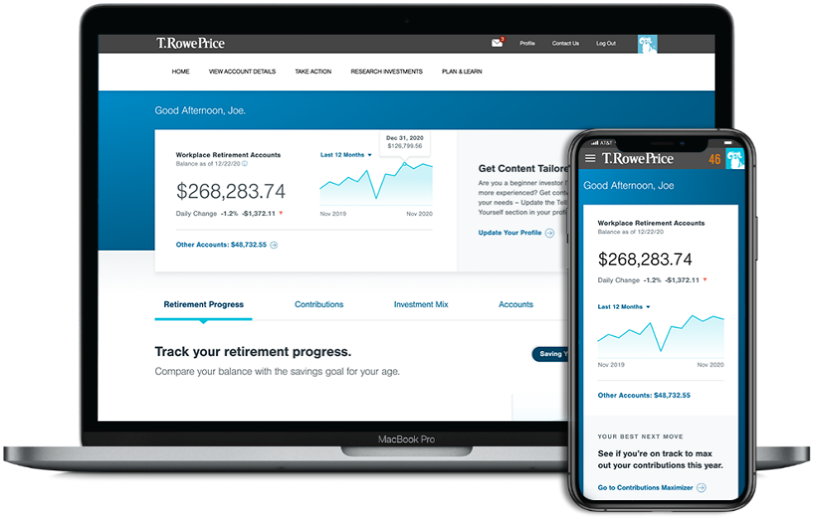
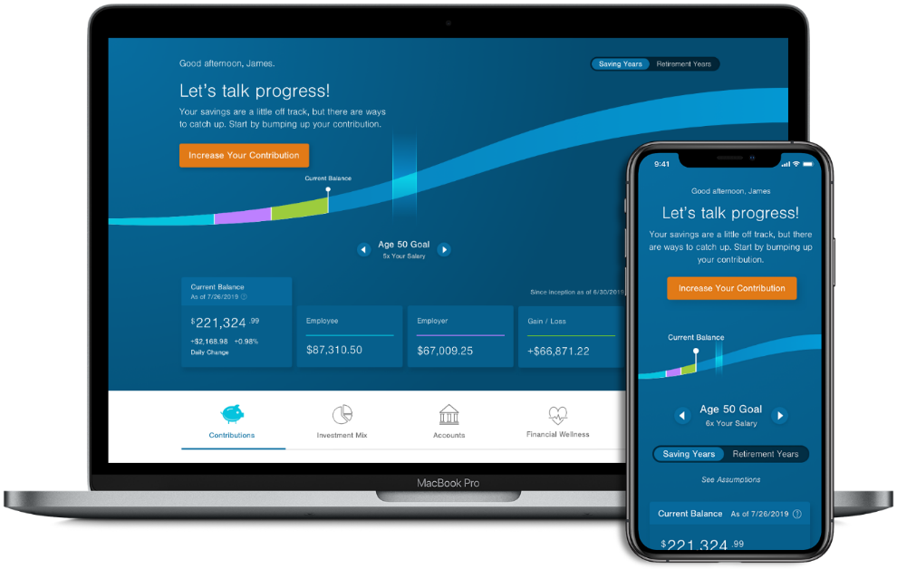
Monitor your account
Note: tips and tools to help you plan for retirement, save for college, pay down debt, and more.
Check in on your progress toward retirement
Log in wherever you are, whatever your device
Quickly view and access accounts and balances
rps.troweprice.com | 1-800-354-2351
Notes:
Think of your plan website as a one-stop source for information, insights, and tools around financial wellness and retirement.
And just call us. Our retirement plan specialists will help you get the answers and information you need.
Thank you for your interest and attention. Now, let's try to answer any questions you may have.
More personalization. Less clicking. Your redesigned, personalized homepage will give you quicker access to helpful comparisons and modeling tools—so you can see how your balance, savings rate, investment mix, and retirement income compare with expert recommendations. You’ll also find suggested actions you can take, based on your real-life situation—small, practical steps designed to help you reach your retirement goals.
Chart your savings progress. Every time you log in, the first thing you’ll see is a personalized road map showing your progress on the road to retirement. Just use the slider to see how much we think you’ll need to have saved at each decade of your life. You can also experiment with changing your savings rate—in the “Contributions” section—and preview the impact on your paycheck and your total contribution.
Planning resources picked just for you. You’ll find personalized information and easy-to-use tools to help you plan for retirement—and beyond. You might also receive a personalized SmartVideo with information that can help you take small, positive steps toward your retirement goals.

Slide 42

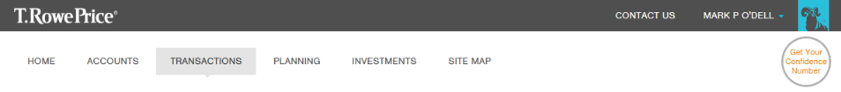
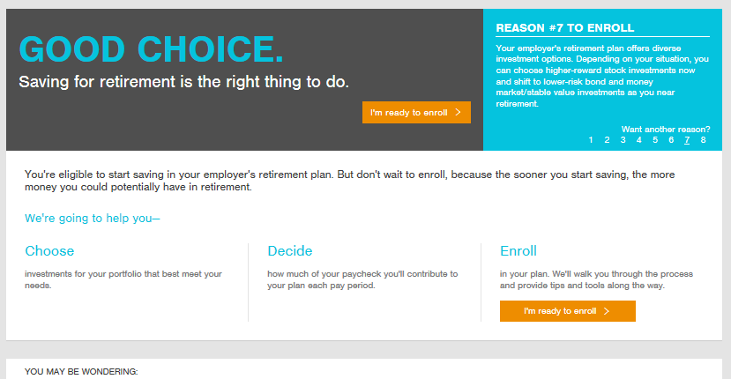
Getting started
OMNI VERSION
Notes:
[static slide – will not change]
Rep Talking Points:
Getting started in the plan is easy
We walk you through the process
Provide answers to common questions along the way

Slide 43
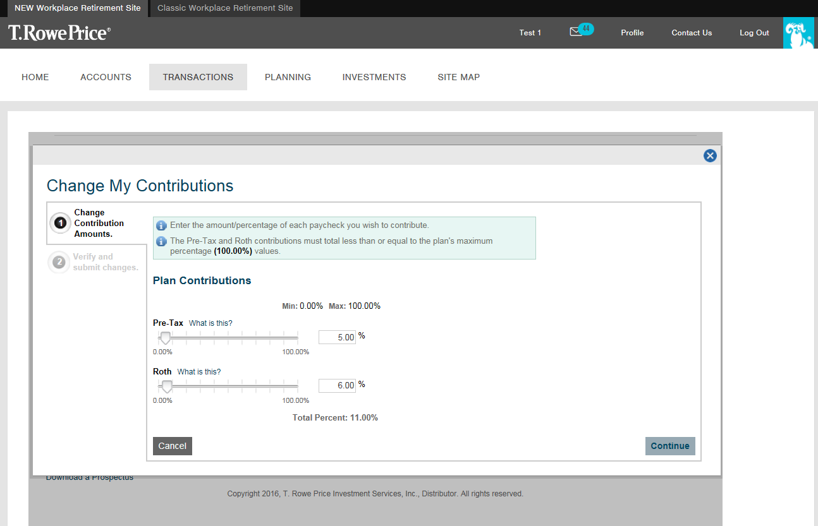
Getting started
TRAC VERSION
Notes:
[static slide – will not change]
Rep Talking Points:
Getting started in the plan is easy
We walk you through the process
Provide answers to common questions along the way

Slide 44

It’s your future.
Notes:
Drive Home Calls to Action

Slide 45

Save enough for retirement.
Notes:
Drive Home Calls to Action: Save 15%

Slide 46

Contact us for help
Notes:
Drive Home Calls to Action: Contact us for help

Slide 47




1-800-922-9945 rps.troweprice.com
©2022 T. Rowe Price. All Rights Reserved. T. ROWE PRICE, INVEST WITH CONFIDENCE, and the Bighorn Sheep design are, collectively and/ or apart, trademarks of T. Rowe Price Group, Inc. RETIRE WITH CONFIDENCE is a trademark of T. Rowe Price Group, Inc.
T. Rowe Price Retirement Plan Services, Inc.
CCON0134375 202210-2558619
Notes:
[static slide – will not change]
Rep Talking Points:
Final slide – Wrap up presentation
Leave this slide up for attendees to take website and phone number down

Slide 48
1-800-354-2351 rps.troweprice.com
©2022 T. Rowe Price. All Rights Reserved. T. ROWE PRICE, INVEST WITH CONFIDENCE, and the Bighorn Sheep design are, collectively and/ or apart, trademarks of T. Rowe Price Group, Inc. RETIRE WITH CONFIDENCE is a trademark of T. Rowe Price Group, Inc.
T. Rowe Price Retirement Plan Services, Inc.
CCON0134375 202210-2558619
Notes:
[static slide – will not change]
Rep Talking Points:
Final slide – Wrap up presentation
Leave this slide up for attendees to take website and phone number down

Slide 49
To Plan Sponsors and Attendees
This presentation should only be used as a visual presentation for T. Rowe Price Retirement Plan Services, Inc., client meetings. This program should not be altered in any manner.
To Web Meeting Attendees
For security reasons, please do not speak or email any personal information during this meeting. For example, you should not give your address, Social Security number, or account information during this web meeting.

