Slide 2

Important Information
TERMS OF USE
By using this presentation, you understand and agree to the following:
You understand that T. Rowe Price does not undertake to give investment advice in a fiduciary capacity by making available this presentation and that T. Rowe Price Associates, Inc., and/or its affiliates (“T. Rowe Price”), may receive revenue from products and services made available by T. Rowe Price, including investment management, servicing, or other fees related to making available and/or servicing certain investments on its recordkeeping platform.
To the extent you modify this presentation, you will not attribute this presentation to T. Rowe Price through co-branding or otherwise.
To the extent you provide investment recommendations to clients or prospective clients, you will not attribute any such recommendation(s) to T. Rowe Price.
You are responsible for satisfying all applicable regulatory standards relating to this communication’s use by your firm, including all applicable content, approval, recordkeeping, and filing requirements.
As long as you agree to these terms, T. Rowe Price grants you a limited, personal, nontransferable, non-sublicensable, revocable, nonexclusive license to use this presentation in its entirety and only in the manner expressly permitted by T. Rowe Price.
Please insert your data/content where indicated and delete these terms of use and various instructions throughout the PPT before using.
LRN 2844704

Slide 3
Important Information
TERMS OF USE
T. Rowe Price Retirement Plan Services, Inc. and [XXXXXX] are not affiliated.
This material is provided for general and educational purposes only, and not intended to provide legal, tax or investment advice. This material does not provide recommendations concerning investments, investment strategies or account types; and not intended to suggest any particular investment action is appropriate for you. Please consider your own circumstances before making an investment decision.
The material does not constitute a distribution, an offer, an invitation, a personal or general recommendation or solicitation to sell or buy any securities in any jurisdiction or to conduct any particular investment activity.
Information and opinions presented have been obtained or derived from sources believed to be reliable and current; however, we cannot guarantee the sources’ accuracy or completeness. The views contained herein are as of the date noted on the material and are subject to change without notice; these views may differ from those of other T. Rowe Price group companies and/or associates. Under no circumstances should the material, in whole or in part, be copied or redistributed without consent from T. Rowe Price.
Unless indicated otherwise the source of all market data is T. Rowe Price.
T. Rowe Price Retirement Plan Services, Inc.
© 2023 T. Rowe Price. All Rights Reserved. T. ROWE PRICE, INVEST WITH CONFIDENCE, and the Bighorn Sheep design are, collectively and/or apart, trademarks of T. Rowe Price Group, Inc.
LRN 2844704

Slide 4

WELCOME
RETIREMENT READINESS
Plan Name
Notes:
Hello, and welcome to Retirement Readiness, a presentation by T. Rowe Price – your retirement plan service provider.
Today we’ll discuss what “Retirement Readiness” may mean for you, and how can you better prepare for retirement, especially as that date draws near.
We’ll explore common questions investors have, and how you can leverage resources at T. Rowe Price to ensure you are “Retirement Ready”.

Slide 5
To Plan Sponsors and Attendees This presentation should only be used as a visual presentation for T. Rowe Price Retirement Plan Services, Inc., client meetings. This program should not be altered in any manner.
To Web Meeting Attendees For security reasons, please do not speak or email any personal information during this meeting. For example, you should not give your address, Social Security number, or account information during this Web meeting.
This material has been prepared by T. Rowe Price Retirement Plan Services, Inc., for general and educational purposes only. This material does not provide recommendations concerning investments, investment strategies, or account types. It is not individualized to the needs of any specific investor and Is not intended to suggest that any particular investment action is appropriate for you, nor is it intended to serve as the primary basis for investment decision-making. T. Rowe Price Retirement Plan Services, Inc., its affiliates, and its associates do not provide legal or tax advice. Any tax-related discussion contained in this presentation, including any attachments/links, is not intended or written to be used, and cannot be used, for the purpose of (i) avoiding any tax penalties or (ii) promoting, marketing, or recommending to any other party any transaction or matter addressed herein. Please consult your independent legal counsel and/or tax professional regarding any legal or tax issues raised in this material.
Notes:
[SILENCE—KEEP ON SCREEN FOR 3 SECONDS
Note: Recording can be paused if participant wants to view for longer]

Slide 6


re∙tire∙ment
/rә`ti(ә)r mәnt/
noun
The action or fact of leaving one’s job and ceasing to work.
Notes:
Retirement—it’s on your horizon. But what does it really mean?
The dictionary defines retirement as “the action or fact of leaving one’s job and ceasing to work.”
For some, it’s spending more time with family or volunteering. For others, its time spent on hobbies, working part time, or traveling.
No matter how you imagine your life in retirement, almost everyone faces the same challenges and questions. However, the individual solutions to these challenges and questions may be different.

Slide 7

Do I Have Enough?
Am I On Track?
How Much Do I Need?
Can I Retire Early?
Notes:
The four top questions we hear from investors as they approach retirement are:
Do I have enough saved?
Am I on track for the retirement I want?
How much will I need to retire?
Can I afford to retire early?
Today, we’ll explore these questions and highlight some online tools and resources that can help you prepare for the future you want.
First, let’s address the question of “How much do I need to retire?” Just like when you define any financial goal, finding out “how much” you will need to reach your goal is key in getting started AND it can help you answer those other important questions.

Slide 8
REPLACEMENT INCOME
T. Rowe Price believes that investors will need 75% of their income in retirement.
Wages
Savings
Social Security
Pensions
75%
Notes:
We believe that most investors should plan to replace at least 75% of their current income to maintain their current standard of living in retirement. That 75%, known as replacement income, is typically composed of various income sources, including: • Wages from a part-time job,
• Retirement savings,
• Social Security, and
• Pension income.
Understanding these different sources, and how they’ll work together, can help you get a better picture of your retirement income outlook.

Slide 9
84
%
of workers expect Social Security to be an income source
88
%
of current retirees report Social Security as an income source
Source: Employee Benefit Research Institute and Mathew Greenwald & Associates, Inc., 2019 Retirement Confidence Survey®
Notes:
All too often, there is a disconnect between where people think their retirement income may come from—or how much they may receive from certain sources— and what they actually receive.
When we compare the expectations of workers today to the circumstances of current retirees, we uncover some interesting findings.
For example, about 84% of workers expect Social Security to be an income source in retirement. But in reality, 88% of current retirees report Social Security as part of their income.
This means that even if you don’t expect Social Security to play a role in your retirement income, it may still be available for you in some form.

Slide 10
82
%
of workers expect their employer-sponsored savings to be an income source
54
%
of current retirees report employer-sponsored savings as an income source
Source: Employee Benefit Research Institute and Mathew Greenwald & Associates, Inc., 2019 Retirement Confidence Survey®
Notes:
When we look at retirement savings, we see even larger discrepancies between today’s workers and retirees.
About 82% of workers expect their employer- sponsored savings to play an important role in their retirement income, but just 54% of current retirees report employer-sponsored savings as an income source. This gap shows that the workers plans were different than their reality in retirement. They may have chosen to rely on other income sources such as personal savings or a part-time job, but they also may have been forced to rely on other income sources because their employer-sponsored savings didn’t last as long as they expected.
This same study also found that although 67% of workers are confident that they will have enough money for retirement, only 42% have actually tried to calculate how much money they will need.
Both of these data points show that workers need to have more of an emphasis on retirement planning to make sure their savings will be able to last them throughout retirement.

Slide 11

What role will
your retirement
savings play?
Notes:
As you can see, it’s a good idea to plan ahead and think about your different sources of retirement income and how they will all work together.
Let’s focus on the role retirement savings will play first.
To begin, it’s important to get a comprehensive view of your savings. If you have multiple retirement accounts, view them together to understand your retirement savings as a whole.
This will help you tackle other questions on our list: “Do I have enough saved?” and “Am I on Track”

Slide 12
RETIREMENT SAVINGS: HOW MUCH SHOULD I HAVE?
Investor's Age: | Savings Benchmarks:
30 | half of salary saved today
35 | 1x to 1.5x salary saved today
40 | 1.5x to 2.5x salary saved today
45 | 2.5x to 4x salary saved today
50 | 3x to 5.5x salary saved today
55 | 4.5x to 8x salary saved today
60 | 6x to 11x salary saved today
65 | 7x to 13.5x salary saved today
15%*
Investors should strive to
SAVE
6%
AT LEAST
Consider increasing contributions by 2% gradually to build toward 15% target
*Including company match
Assumptions: Benchmarks are based on a target multiple at retirement age and a savings trajectory over time consistent with that target and the savings rate needed to achieve it. Household income grows at 5% until age 45 and 3% (the assumed inflation rate) thereafter. Investment returns before retirement are 7% before taxes, and savings grow tax-deferred. The person retires at age 65 and begins withdrawing 4% of assets (a rate intended to support steady inflation-adjusted spending over a 30-year retirement). Ranges are based on individuals or couples with current household income between $75,000 and $250,000. Refer to the T. Rowe Price Insights piece "Are My Retirement Savings on Track?" for additional information.
Notes:
Fortunately, two simple factors can help investors answer this question of how much is enough: an investor’s age and their salary.
In order to retire and maintain the same lifestyle as you currently have, we believe you should aim to save the specified multiples of your current salary by your respective ages.
The savings targets shown here assume a retirement age of 65. They also assume that most retirement savers should plan to replace 75% of their pre-retirement income to maintain their lifestyle during a 30—year retirement.
While some of these numbers may look intimidating, especially in those later years, remember that compounding is also working for you. So, it’s important to focus on saving early and often.
In order to accomplish these goals, we at T. Rowe Price believe you should save at least 15 percent of your salary each year for retirement, [including any company contributions]. If your budget doesn’t allow for that, save what you can now; we suggest starting with at least 6%. Then increase your contributions by 2% or more each year. Over time, you’ll reach that 15% target savings rate and feel more confident about your progress towards your retirement vision.

Slide 13
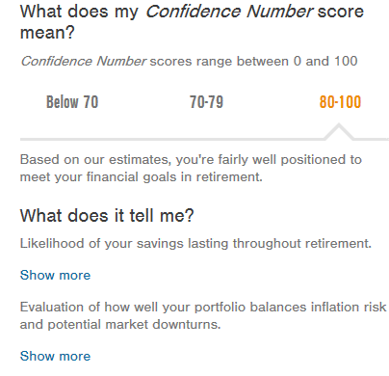
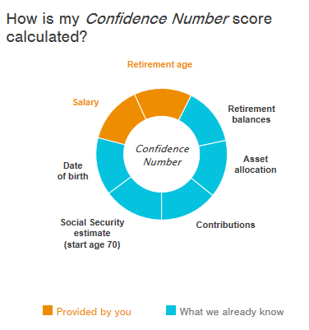
GET YOUR CONFIDENCE NUMBER® SCORE
Retirement age
Salary
Notes:
A great way to gauge if you are on track for retirement is to utilize the Confidence Number tool on your online account. You’ll find it in the Planning section of your Workplace Retirement Website at rps.troweprice.com.
Your Confidence Number score will help you understand the likelihood that you’ll have enough savings to last through retirement.
While it does not guarantee retirement readiness, it can serve as a helpful indicator if you are on the right track.
To calculate your score, just answer two questions:
• What’s your current salary? and
• At what age do you plan to retire?
Keep in mind you can always update these numbers as your salary or retirement goals change. Your Confidence Number score is an estimate based on a scale of 0 to 100. The higher your score, the more prepared you may be for retirement.
Your score is calculated based on key pieces of information that typically impacts your future retirement income. This includes: your retirement balances, asset allocation, contribution amount, Social Security estimates, and your date of birth.

Slide 14
IMPORTANT: The projections or other information generated by the Confidence Number score regarding the likelihood of various investment outcomes are hypothetical in nature, do not reflect actual investment results, and are not guarantees of future results. The simulations are based on assumptions. There can be no assurance that the projected or simulated results will be achieved or sustained. Actual results will vary with each use and over time, and such results may be better or worse than the simulated scenarios. Clients should be aware that the potential for loss (or gain) may be greater than demonstrated in the simulations.
T. Rowe Price Investment Services, Inc.

Slide 15
THE LEVERS: WHAT CAN I ADJUST?
LESS
MORE
Wages
savings
Social security
household plan
Notes:
Now, let’s look at our final question: “Can I retire early?”
The answer here depends entirely on your retirement readiness and all the various factors at play.
If you do want to retire early, we believe that you should be thinking about the different “levers” of your retirement income. What can you adjust to change your outlook and timeline?
Could you work a part-time job in retirement? What about increasing your retirement savings? Remember, once you’re age 50 or older, you can make catch-up contributions to your retirement plan accounts and any IRAs.
In addition, you might consider delaying Social Security to maximize your benefit. And, of course, you can always adjust your household plan and consider making adjustments to your household budget.
Just remember: The power to retire how and when you want is in your control—even when it comes to issues that might feel out of your control, such as Social Security.

Slide 16
IMPACT OF DELAYING SOCIAL SECURITY BENEFITS
Annual Social Security payment at age 70:
$24,348
$24,348
$12,756
Annual Social Security payment at age 62:
$12,756
Social Security payments calculated using the Social Security Administration’s Quick Calculator. This assumes an individual who turns age 62 in 2020 (date of birth 1/15/58) who is continuing to work and earning $50,000 each year until benefits begin. The analysis uses Social Security’s default assumptions for prior earnings history. All figures reflect current dollars (no inflation or future earnings increases).
If an individual initiates Social Security benefits prior to full retirement age (66 and 8 months in this example), annual retirement benefits from Social Security are reduced by 6⅔% annually for the first 3 years of early retirement and by 5% for additional years. Waiting past full retirement age adds 8% per year to benefits. The illustration also reflects a small impact from additional years of earnings replacing years with different indexed earnings. These results are for illustrative purposes only and are generic in nature.
Source: Social Security Administration Quick Calculator Benefit Estimates June 2020, https://www.ssa.gov/oact/quickcalc/.
Notes:
The truth is, you have more control over your Social Security benefits than you might think, AND your decisions around Social Security could make a big difference in your retirement income.
Remember: Social Security is a paycheck for life, whereas income from your retirement savings will change and deplete as it is withdrawn.
To get the most out of Social Security, consider delaying your benefits. For every year you delay—up to age 70—your benefit goes up about 7% to 8%.
While you can file for reduced benefits at age 62, it’s usually best to wait. Simply keep your sight on the big picture knowing that you will also be increasing the amount of your Social Security benefits.
Be sure to still consider the many factors that can affect your claiming decision like life expectancy, income needs, and what would be best for both you AND your spouse.
To learn more about Social Security, visit the Social Security Administration’s website at ssa.gov. You’ll find calculators and tools that can help you estimate your benefits and better understand the income you’ll receive from Social Security.

Slide 17
YOU HAVE OPTIONS
YOUR RETIREMENT SAVINGS
Address Current Expenses
Defer Taxes
Cash distribution
leave in current plan
New employer’s plan
Rollover IRA
Notes:
Once you reach retirement, you’ll have to decide what to do with your savings.
When it comes to your retirement savings, your plan offers the following options:
1. Address current expenses with a cash distribution or 2. Defer taxes by keeping your savings in your current plan, a new employer's plan, or in a Rollover IRA.
Each option may have pros and cons, depending on your unique circumstances. To help ensure that you understand the potential tax consequences associated with each, we recommend that you talk to a tax professional who can help you determine how it may affect your specific situation.

Slide 18
RETIREMENT INCOME: FIRST YEAR
OUR RULE OF THUMB
4
%
Increase dollar amount by
3% in subsequent years
(based on 3% inflation
assumption)
Notes:
Your first year of retirement is exciting. But it’s also critical to establishing a reliable stream of retirement income.
We believe 4% is a good starting point for a withdrawal strategy. This means that in the first year of retirement, our general rule of thumb is to withdraw up to 4% of your retirement account balance. After that, reevaluate your spending needs each year. Individuals who retire earlier may need to consider taking less. Conversely, people who retire later may be able to take more than 4%.
After the first year, consider increasing your withdrawal amount by 3% each subsequent year to account for inflation, but also consider your spending needs.
It’s important to remember that a person’s savings may need to last throughout retirement, which can last for 30 years or more.

Slide 19
RETIREMENT INCOME: $500,000 SAVED
$21,218 withdrawal ($20,600 x 1.03)
$20,600 withdrawal ($20,000 x 1.03)
$20,000 withdrawal ($500,000 x 4%)
This illustration is hypothetical and not representative of any specific investment or strategy. All investments involve risk, including possible loss of principal. Assumes $500,000 initial investment, 4% first-year withdrawal, with subsequent years increased by annual inflation of 3%
Notes:
Now, let’s look at an example to get a better idea of what this withdrawal strategy looks like.
Let’s assume an individual goes into retirement with
$500,000 saved. If they followed the 4% withdrawal strategy, they would withdraw $20,000 during their first year of retirement.
For the second year, they would simply increase that
$20,000 by 3%. That would give them $20,600.
And for the third year, they would increase that by another 3%—giving them $21,218.
That’s just their “paycheck” from their retirement savings, you can map out scenarios where you add other sources of income like Social Security and/or wages from a part time job.

Slide 20
RETIREMENT INCOME: MULTIPLE SOURCES
1
2
3
TAX-DEFERRED ACCOUNTS
TAXABLE ACCOUNTS
TAX-FREE ACCOUNTS
Notes:
T. Rowe Price published an article on tax-efficient withdrawal strategies and this information is available to you on our website. Keep in mind, you’ll need to consider your own personal circumstances before implementing a withdrawal strategy.
You may have different accounts, like Taxable Accounts, Tax-Deferred accounts such as a pretax 401(k) and/or a Traditional IRA, and/or Roth Accounts such as Roth 401(k)s and/or Roth IRAs.
Our rule of thumb is to withdraw from taxable accounts first, followed by tax-deferred accounts, and finally, Roth assets.
There is a logic to this approach; it allows tax-advantaged accounts to stay invested longer—giving them more time to grow.

Slide 21
MILESTONE AGES
age 50
age 55
age 59½
age 62
age 65*
age 70
age 73**
Eligible For
Catch-Up
Contributions
Penalty-Free
Withdrawal
Provision
10% Early
Withdrawal Penalty No
Longer Applies
Eligible For
Reduced
Social Security
Benefits
Eligible For
Medicare
Claim Social
Security Benefits
If You Haven’t
Already
Required
Minimum
Distributions
*Medicare has an initial enrollment period of 7 months: the enrollment period begins 3 months before the month you turn 65, includes the month you turn 65, and ends 3 months after you turn 65. **If you will turn 72 on or after January 1, 2023, your first required minimum distribution (RMD) will not be required until 2024. The new deadline for taking your first RMD is April 1 following the year in which you turn 73 or the year that you stop working for your employer, if later. If are you still employed at that time, your employer may allow you to delay your first RMD until the April 1 following the year in which you terminate employment. If you turned 72 in 2022, you must still take your RMD by April 1, 2023, and continue to take RMDs no later than each December 31 after that. If you turned 72 in 2022 and are still working, you must still take your RMD by the April 1 following the year you no longer work for your employer.
If you turned 70½ in 2019, you must still take your RMD by April 1, 2020, and continue to take RMDs no later than each December 31 after that. If you turned 70½ in 2019 and are still working, you must still take your RMD by the April 1 following the year you no longer work for your employer.
Notes:
As investors plan and prepare for retirement, knowing exactly what to do—and when—can be challenging. Fortunately, there are a few milestones that can help investors along the way.
Beginning the year investors turn age 50, they’re eligible to save more by making catch-up contributions to their retirement plan based on the IRS Contribution Limits.
Next, turning age 55 brings an early retirement benefit. From this age forward, if someone retires, he or she is eligible to take withdrawals from his or her current workplace retirement plan without having to pay the 10% early withdrawal penalty. Note: this rule does not apply to IRAs or former employers’ plans, if the investor was not at least age 55 when he or she left that employer.
Although it’s only a “half birthday,” turning age 59 and a half is a major retirement milestone. From this point forward, an investor may be able to begin withdrawing money from his or her retirement plan accounts—including IRAs—without paying the 10% early withdrawal penalty.
At age 62, investors can begin receiving reduced Social Security benefits, however investors should consider delaying these benefits. Waiting just a few years to claim Social Security can increase both monthly and lifetime benefits.
At age 65, Americans are eligible to enroll in Medicare. Remember, enrollment in Medicare does not happen automatically. Enrollees need to take care of this during a seven-month window, which includes the three months before their 65th birthday.

Slide 22
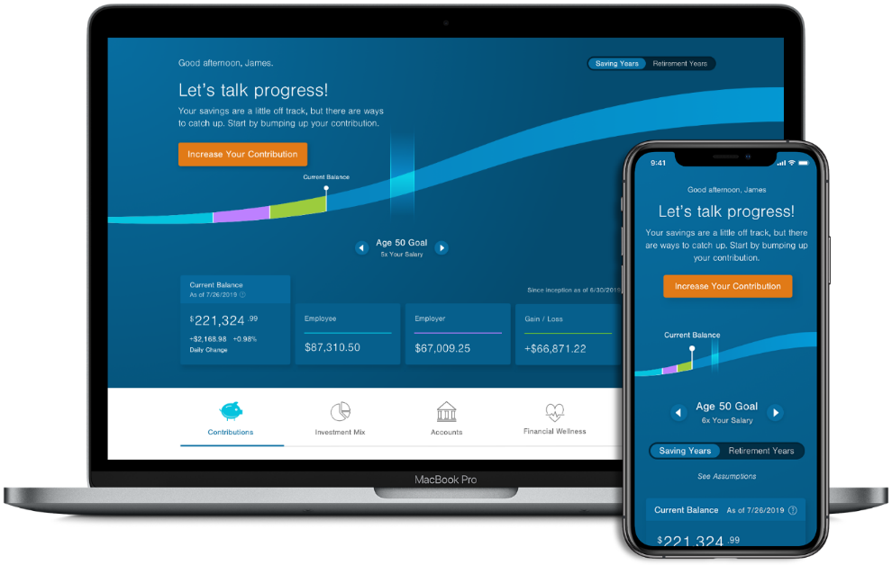
MONITOR YOUR ACCOUNT
Check in on your progress toward retirement
Note: tips and tools to help you plan for retirement, save for college, pay down debt, and more
Log in wherever you are, whatever your device
Quickly view and access accounts and balances
rps.troweprice.com
Notes:
Over time don’t forget to monitor your account to make sure you’re still on track for retirement.
Think of your plan website as a one-stop source for information, insights, and tools around financial wellness and retirement.
Your personalized homepage allows you to see how your balance, savings rate, and investment mix compare with our savings and investment benchmarks.
Use the slider to see savings milestones for each decade of your life. You can also experiment with changing your savings rate and preview how it would impact your paycheck
Once you’ve explored the homepage, check out the rest of your workplace retirement website. You’ll find tons of planning resources to help you plan for retirement—and beyond.

Slide 23

CLOSING REMARKS.
Notes:
Remember: It’s your future. And it’s shaped by what you do today. Enroll in your plan and take advantage of all the good things it has to offer. Start today, save early and often, and feel confident knowing you’ve taken a positive step toward the retirement you envision. If you encounter questions or challenges along your journey to retirement, we’re here to help.

Slide 24





1-800-922-9945 rps.troweprice.com
© 2023. T. Rowe Price. T. ROWE PRICE, INVEST WITH CONFIDENCE, and the bighorn sheep design are, collectively and/or apart, trademarks of T. Rowe Price Group, Inc. All rights reserved.
T. Rowe Price Retirement Plan Services, Inc.
CCON0080164
202301-2701634
Notes:
Thank you for your time today. We hope you found this presentation helpful. All investments involve risk, including possible loss of principal.

